Slide 1



Poultrivet
Early Warning of Poultry Disease Risk in Ugandan Smallholder Farms Using Sentinel-2 Indicators and YOLOv8-Based Dropping Image Classification
CSJ1/2025
IYUNDHU KENNEDY KISAME
NSUBUGA JEREMIAH
01
MUKISA RACHAEL JOVIA
YIGA MARVIN ISAAC

Slide 2

83%
of poultry farmers detect disease only after visible clinical symptoms emerge
lack of a system that provides early poultry disease risk warnings using environmental data.
Problem
AI image diagnosis exists in research but isn't deployed for Ugandan smallholders
02

Slide 3

Main Objective
Design and deploy an integrated satellite imagery and AI-based system
Objectives
Specific Objectives
Extract satellite-based environmental risk indicators.
Generate poultry disease risk scores using expert rules.
Develop an AI model for poultry disease detection.
Integrate all components through a FastAPI backend.
Assess usability with Ugandan poultry farmers.
03

Slide 4

Lack of a mobile-accessible system that uses satellite
environmental data to provide district-level
poultry disease risk forecasts for smallholder farmers.
The Gaps
Existing poultry disease detection models have not been adequately trained and evaluated using field-captured poultry dropping images from sub-Saharan Africa.
No mobile application combines environmental risk forecasting and AI-based poultry disease diagnosis in a single platform
04

Slide 5



Our
Solution
Satellite-based disease risk forecasting
Chatbot
Faeacal daigonosis
AL assistant for farmers to chat with
YOLOVn8 Algorithm
05

Slide 6
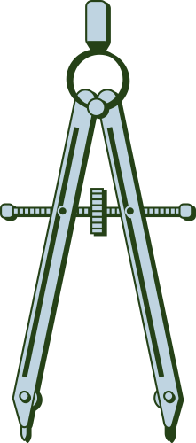

Data Sources
13,000 labelled dropping images across 4 classes
Sentinel-2 + MODIS via Google Earth Engine, plus GAUL 2024 + JRC water bodies
The Architecture
Backend Processing
Mobile App
YOLOv8n training in PyTorch
Flutter App
TFLite on-device (YOLOv8n · 4.3MB · offline)
Firebase Auth + FCM
PouliPal Chat (OpenRouter LLM)
06

Slide 7
Data Collection
13,000 labelled dropping images with 4 classes
Methodology
Model Selection
Experimental Setup
YOLOv8n chosen over YOLOv5, ResNet-50, MobileNetV2
Google Colab(T4 GPU)
Powered by Python, PyTorch, and Ultralytics YOLOv8.
Ran for 40 epochs using Adam optimizer (batch size 16, 640x640 resolution).
07

Slide 8
Model Training
The YOLOv8n model trained in 2.39 hours over 40 epochs on a 9,266-image dataset, achieving a 0.941 validation mAP50. Convergence was stabilized by mosaic augmentation, and a 0.941 mAP50 was finalized following the automated disabling of this augmentation in the final 10 epochs
Methodology
Model Evaluation
System Testing
13,000 labelled dropping images with 4 classes
13,000 labelled dropping images with 4 classes
08

Slide 9
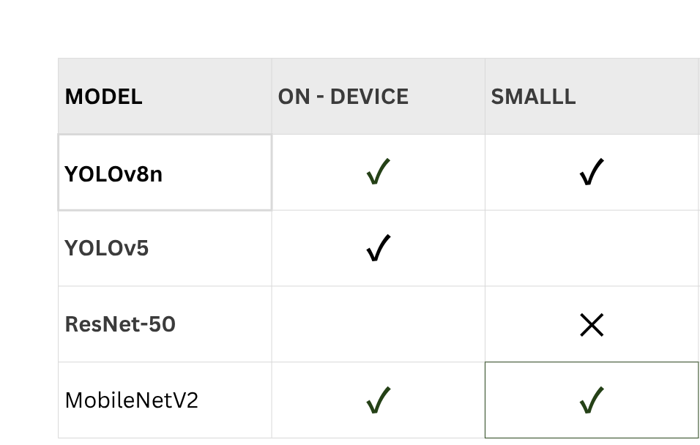
Why YOLOv8n?
09

Slide 10
Satellite Implementation
Google Earth Engine Connection
Loading Uganda District Boundaries
GEE provides access to large-scale satellite datasets
A Python script was used to authenticate and initialize the connection.
Uganda district boundaries obtained from the FAO/GAUL(2024) Level 2 dataset.
These boundaries serve as analysis zones for environmental monitoring.
Extracting the 4 Environmental Indicators
NDVI (Vegetation) and NDMI (Moisture) from sentinel - 2
Land Surface Temperature from MODIS
Water Body Presence from JRC Surface Water
10

Slide 11
Satellite Implementation
Zonal Statistics Computation
risk scoring engine
Mean NDVI calculated
Mean NDMI calculated
Mean Temperature calculated
Mean Water Presence calculated
For each district
It is a rule-based expert system built using epidemiological knowledge from literature
translates environmental conditions into disease risk levels that farmers can easily understand.".
Deployment
Risk scores are exported as JSON files
JSON data is served through:
FastAPI Backend
render Cloud Platform
11

Slide 12
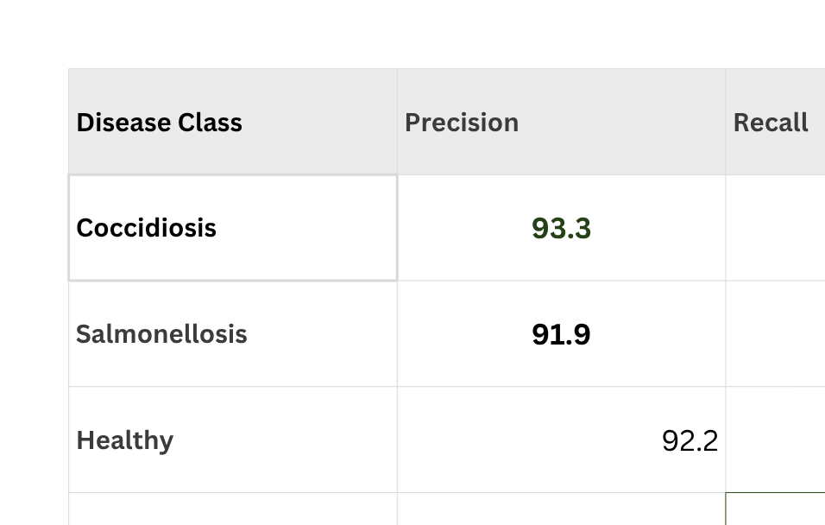
Results
12

Slide 13
Results
The model maintained strong performance on field-captured images, demonstrating that AI-powered poultry disease diagnosis is practical even in rural environments where image quality cannot be controlled
The risk distribution produced by PoultriVet is not random. The high-risk districts are concentrated around environmentally vulnerable regions such as Lake Victoria and the Nile Basin, which agrees with findings reported in veterinary epidemiological literature
13

Slide 14

14

